Slide 1
Introduction to OpenMP

Slide 2
Can my code be parallelized?
Does it have large loops that repeat the same operations?
Does your code do multiple tasks that are not dependent on one another? If so is the dependency weak?
Can any dependencies or information sharing be overlapped with computation
If not, is the amount of communications small?
Do multiple tasks depend on the same data? 
Does the order of operations matter? If so how strict does it have to be?
Notes:
This we can do later

Slide 3
OpenMP introduction
OpenMP stands for “Open Multi-Processing”
OpenMP is a multi-vendor standard to perform shared-memory multithreading
OpenMP uses fork-join model
OpenMP is both directive and library based
Each OpenMP thread has its own stack
OpenMP probably gives you the biggest multithread benefit per amount of work you have to put in to using it

Slide 4
Threads
A thread can be considered to be a lightweight process
A more precise definition is that it is an execution path, a sequence of instructions, that is managed separately by the operating system scheduler as a unit
Threads alleviate the overhead associated with the fork mechanism by copying only the bare essentials needed: the run-time stack
The run-time stack cannot be shared between two threads

Slide 5
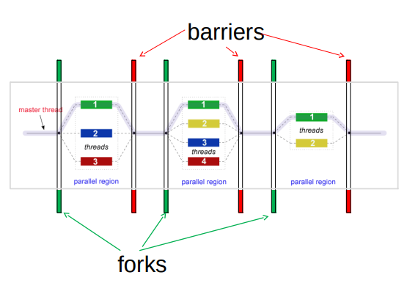
Fork-join model

Slide 6

OpenMP Consortium

Slide 7
What OpenMP Isn’t
OpenMP doesn’t check for data dependencies, data conflicts, deadlocks, or race conditions. You are responsible for avoiding those yourself
OpenMP doesn’t check for non-conforming code sequences
OpenMP doesn’t guarantee identical behavior across vendors or hardware, or even between multiple runs on the same vendor’s hardware
OpenMP doesn’t guarantee the order in which threads execute, just that they do execute
OpenMP is not overhead-free
OpenMP does not prevent you from writing code that triggers cache performance problems

Slide 8
OpenMP: parallel regions
A parallel region within a program is specified as
#pragma omp parallel [clause [[,] clause] …]
Structured-block
A team of threads is formed
Thread that encountered the omp parallel directive becomes the master thread within this team
The structured-block is executed by every thread in the team.
At the end, there is an implicit barrier
Only after all threads have finished, the threads created by this directive are terminated and only the master resumes execution
A parallel region might be refined by a list of clause

Slide 9
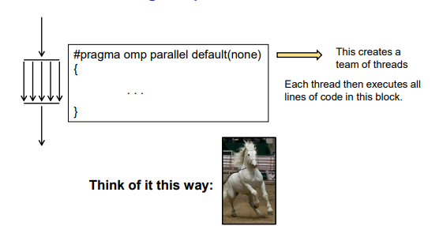
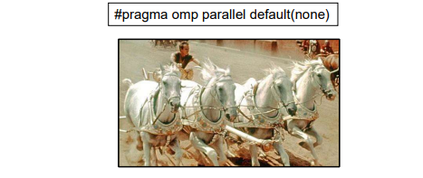
OpenMP: parallel regions

Slide 10
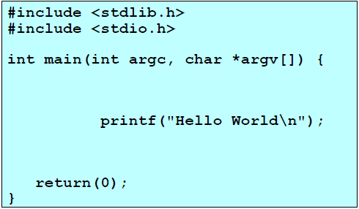
“Hello Word” Example/1

Slide 11
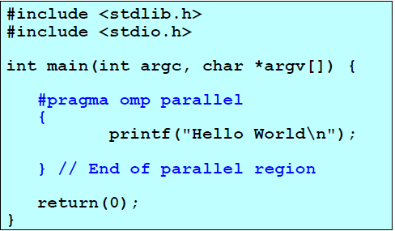
“Hello Word” Example/2

Slide 12
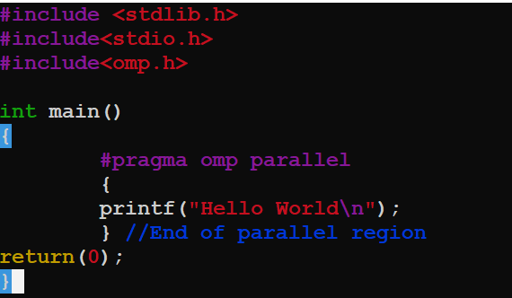
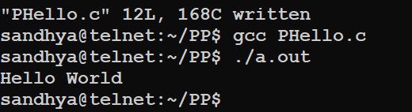
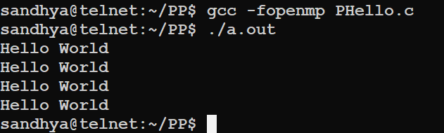
“Hello Word” Example/2

Slide 13
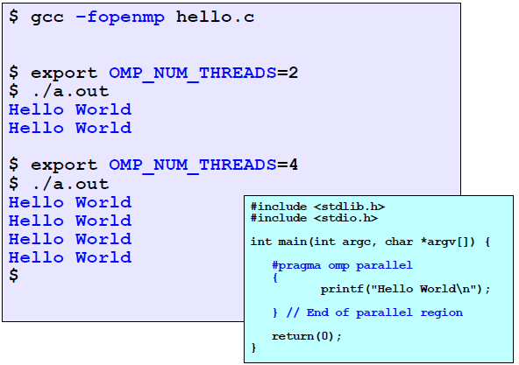
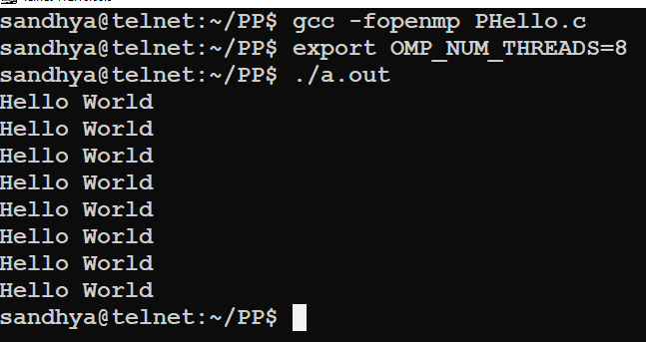
“Hello Word” Example/2

Slide 14
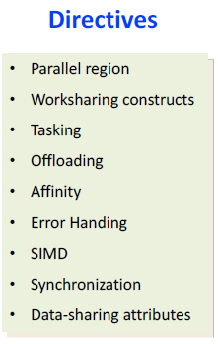
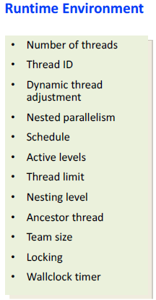
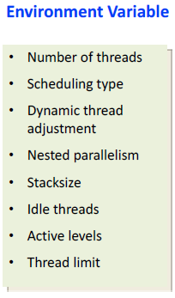
OpenMP Components

Slide 15
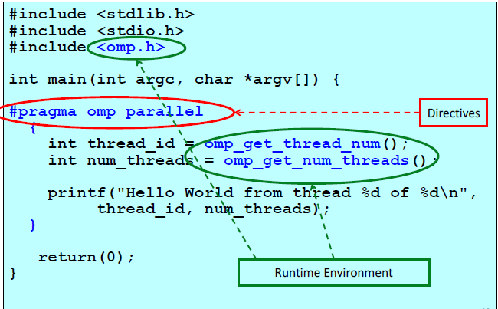
“Hello Word” Example/3

Slide 16
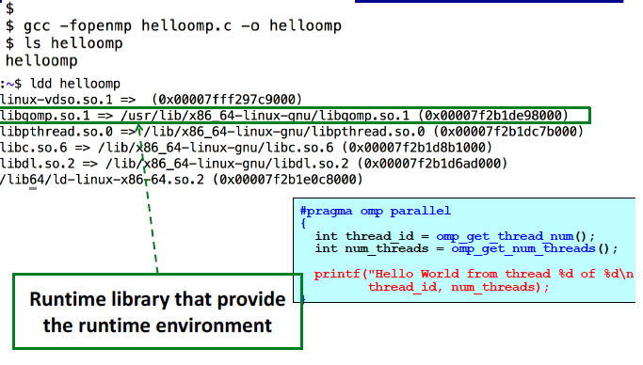
“Hello Word” Example/3

Slide 17
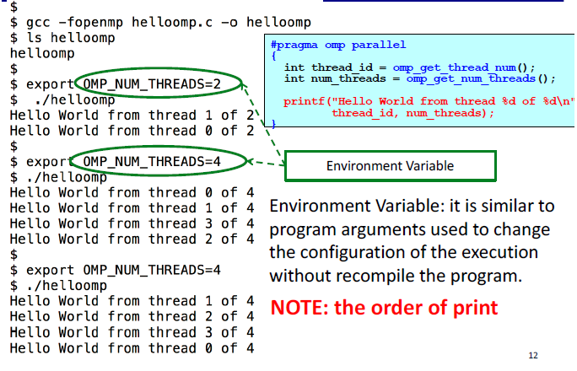
“Hello Word” Example/3

Slide 18
OpenMP Programming Model
Shared memory, thread-based parallelism
–OpenMP is based on the existence of multiple threads in the shared memory programming paradigm.
–A shared memory process consists of multiple threads.
• Explicit Parallelism
–Programmer has full control over parallelization. OpenMP is not an automatic parallel programming model.
•Compiler directive based
–Most OpenMP parallelism is specified through the use of compiler directives which are embedded in the source code.

Slide 19
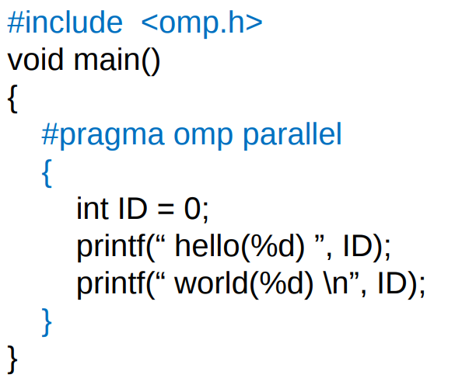
Hello World in OpenMP

Slide 20
OpenMP controlling number of threads
Once a program is compiled, the number of threads can be controlled using the following shell variables
At the program level, via the omp_set_number_threads function:
void omp_set_num_threads(int n)
• At the pragma level, via the num_threads clause:
#pragma omp parallel num_threads(numThreads)

Slide 21
OpenMP controlling number of threads
Asking how many cores this program has access to:
num = omp_get_num_procs( );
Setting the number of available threads to the exact number of cores available:
omp_set_num_threads( omp_get_num_procs( ) );
Asking how many OpenMP threads this program is using right now:
num = omp_get_num_threads( );
Asking which thread number this one is:
me = omp_get_thread_num( )

Slide 22
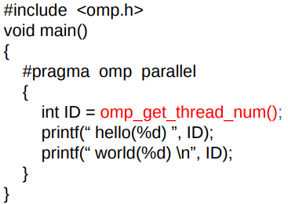
Hello World in OpenMP
Each thread has a unique integer “id”; master thread has “id” 0
Other threads have “id” 1, 2, …
OpenMP runtime function
omp_get_thread_num()
returns a thread’s unique “id”.
What will be the programs output?

Slide 23
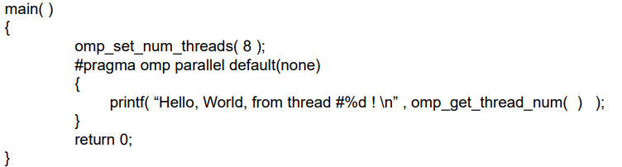
A sample OpenMP program

Slide 24
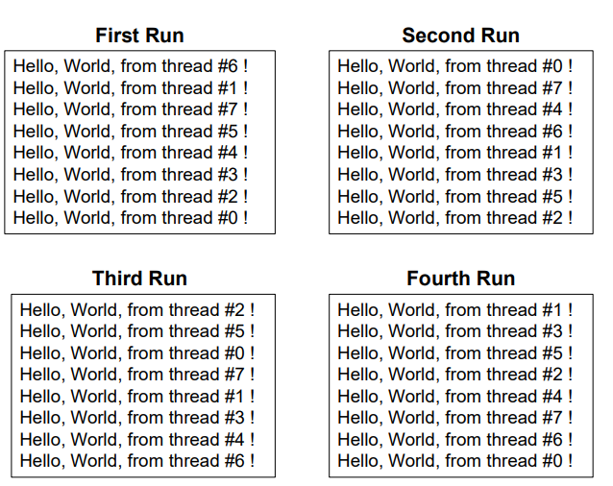
A sample OpenMP program

Slide 25
OpenMP: parallel loops
A parallel for loops are declared as
#pragma omp for [clause [[,] clause] …]
for-loops
Each for loop among for-loops associated with the omp for directive must be in the canonical form
the loop variable is made private to each thread in the team and must be either (unsigned) integer or a pointer,
the loop variable should not be modified during the execution of any iteration;
the condition in the for loop must be a simple relational expression,
the increment in the for loop must specify a change by constant additive expression;
the number of iterations of all associated loops must be known before the start of the outermost for loop.

Slide 26
OpenMP: parallel loops
A clause is a specification that further describes a parallel loop, for instance,
collapse(integer) specifies how many outermost for loops of for-loops are associated with the directive, and thus parallelized together;
nowait eliminates the implicit barrier and thus synchronization at the end of for-loops.

Slide 27
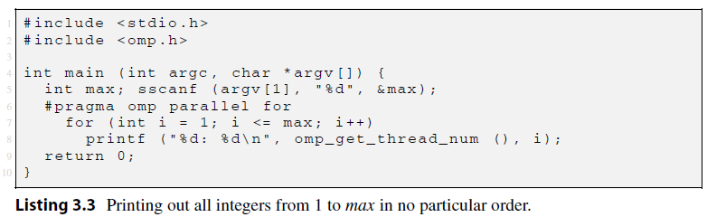
Parallelizing Loops with Independent Iterations
The omp parallel for directive in line 6 specifies that the for loop must be executed in parallel
The iterations of the for loop will be divided among the threads
Once all iterations have been executed, all threads in the team are synchronized at the implicit barrier at the end of the parallel for loop
All slave threads are terminated
Finally, the execution proceeds sequentially, and the master thread terminates the program by executing return 0
Program does not specify how the iterations should be divided among threads.
Notes:
consider printing out
all integers from 1 to some user-specified value, say max, in no particular order

Slide 28
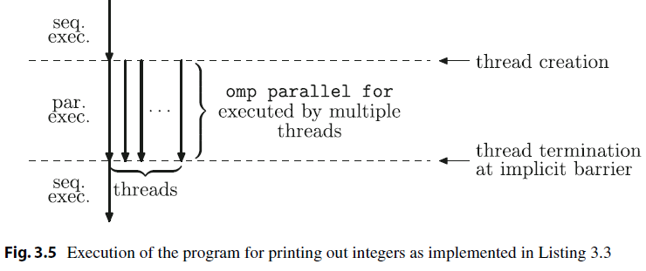

Slide 29
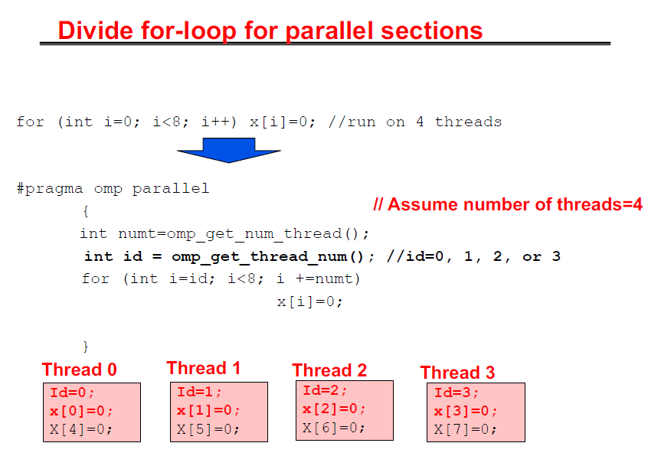

Slide 30
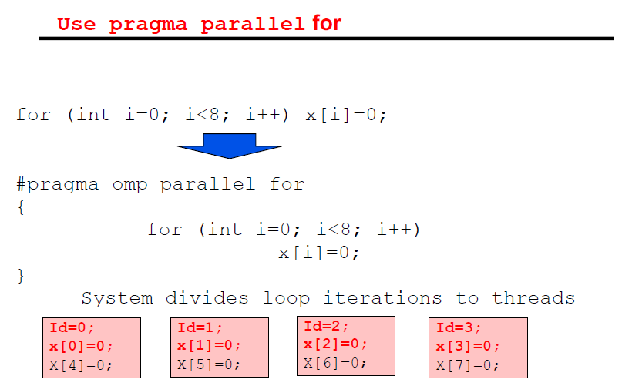

Slide 31
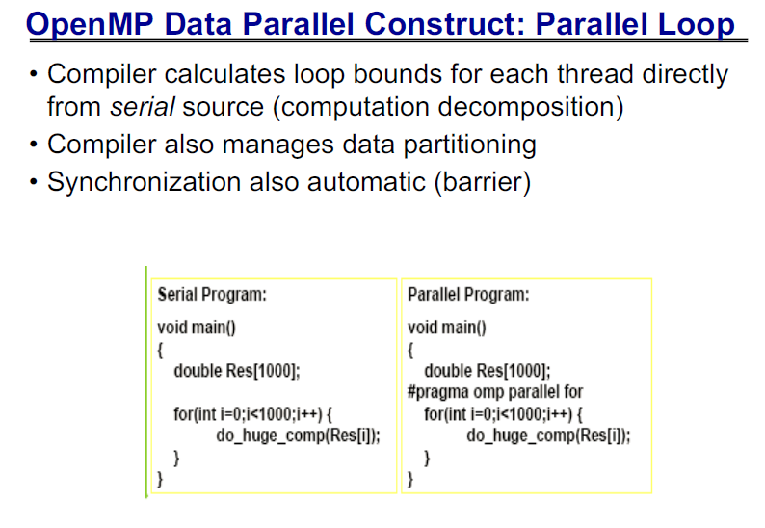

Slide 32
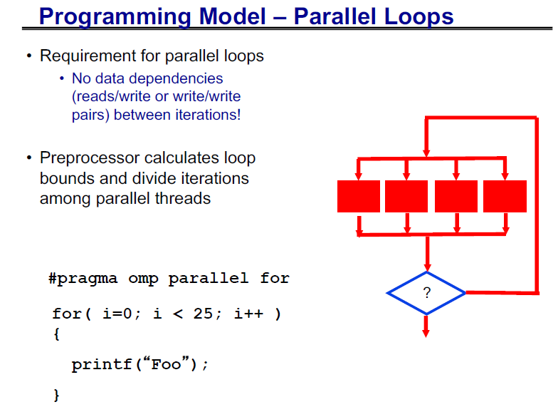

Slide 33
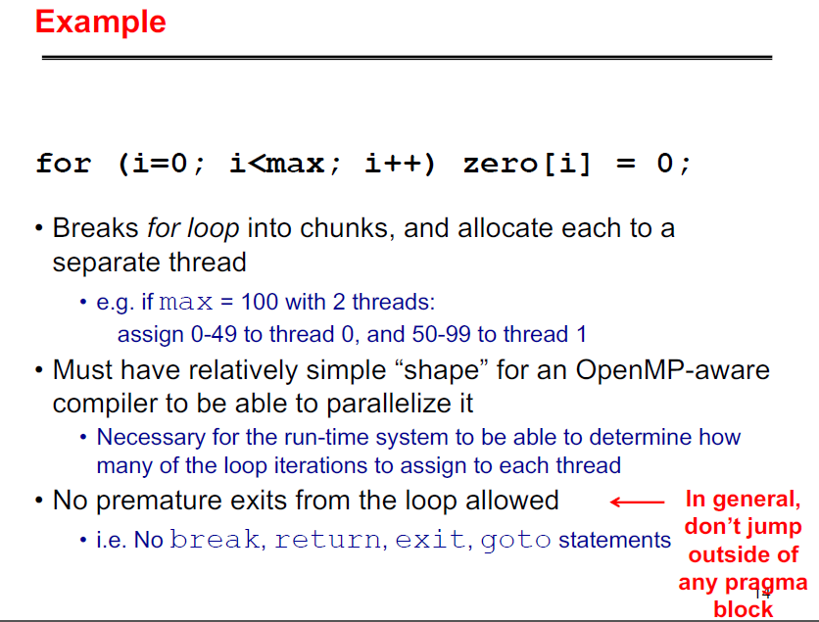

Slide 34
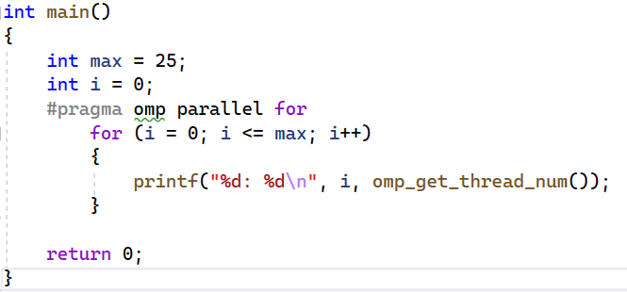
OpenMP: parallel loops
The omp parallel for directive in line 5 specifies that the for loop must be executed in parallel
The iterations of the for loop will be divided among the threads
Once all iterations have been executed, all threads in the team are synchronized at the implicit barrier at the end of the parallel for loop
All slave threads are terminated
Finally, the execution proceeds sequentially, and the master thread terminates the program by executing return 0

Slide 35
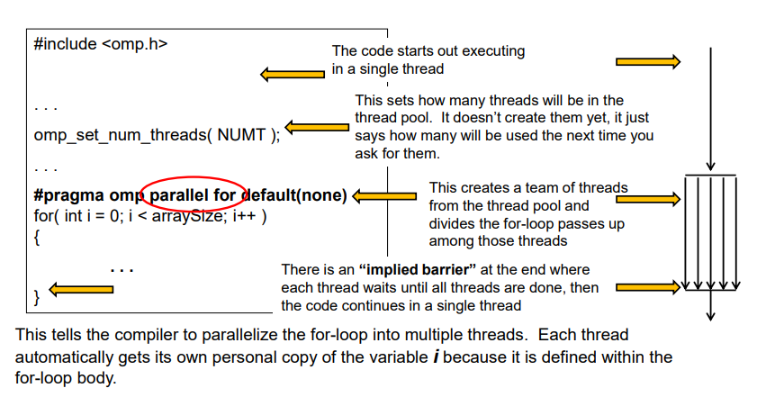
Creating OpenMP threads in Loops

Slide 36
OpenMP: parallel loops
The loop variable is made private to each thread in the team and must be either (unsigned) integer or a pointer
The loop variable should not be modified during the execution of any iteration
The condition in the for loop must be a simple relational expression
The increment in the for loop must specify a change by constant additive expression
The number of iterations of all associated loops must be known before the start of the outermost for loop

Slide 37
OpenMP: parallel loops
The start and terminate conditions must have compatible types
Neither the start nor the terminate conditions can be changed during the execution of the loop
The index can only be modified by the changed expression (i.e., not modified inside the loop itself)
You cannot use a break or a goto to get out of the loop
There can be no inter-loop data dependencies such as:
A[i]=a[i-1]+1;

Slide 38
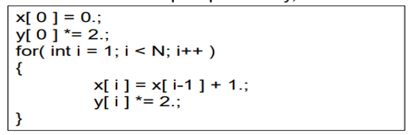
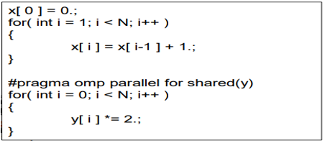
OpenMP: parallel loops

Slide 39
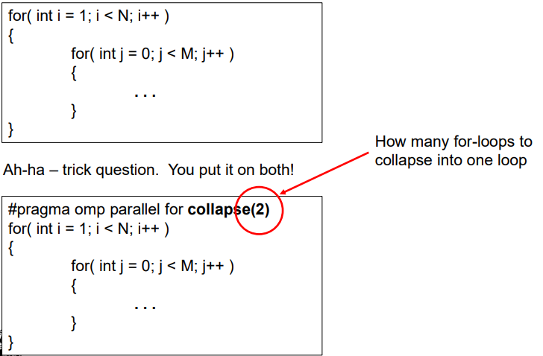
OpenMP: parallel loops

Slide 40
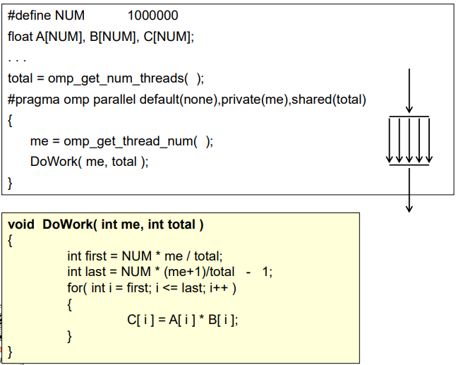
Single Program Multiple Data (SPMD) in OpenMP

Slide 41
OpenMP: Data sharing
Various data sharing clauses might be used in omp parallel directive to specify whether and how data are shared among threads:
shared(list) specifies that each variable in the list is shared by all threads in a team, i.e., all threads share the same copy of the variable
private(list) specifies that each variable in the list is private to each thread in a team, i.e., each thread has its own local copy of the variable
firstprivate(list) is like private but each variable listed is initialized with the value it contained when the parallel region was encountered
lastprivate(list) is like private but when the parallel region ends each variable listed is updated with its final value within the parallel region

Slide 42
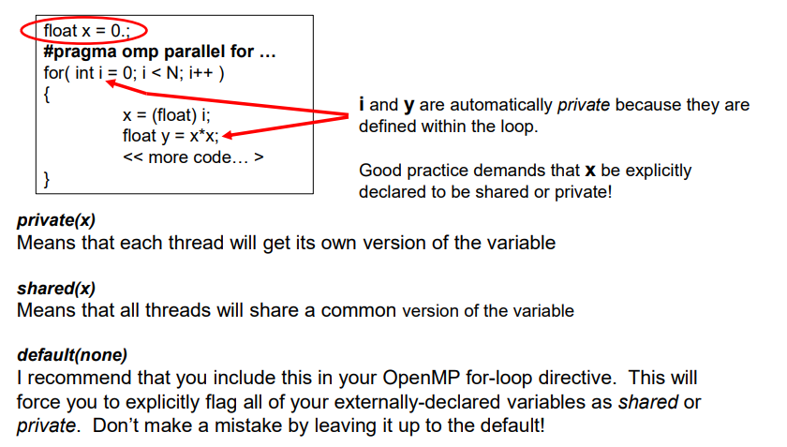
OpenMP: data sharing

Slide 43
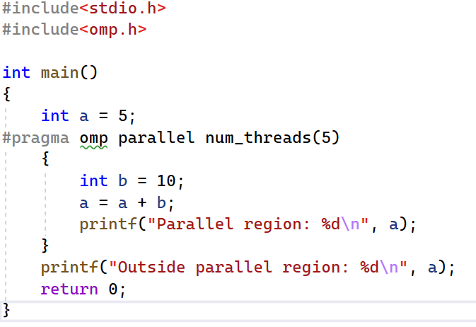
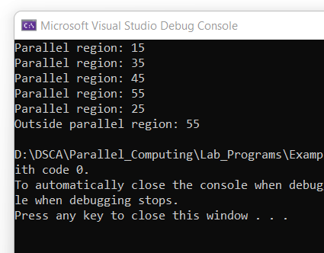
OpenMP: data sharing
If not specified otherwise,
Automatic variables declared outside a parallel construct are shared by default
Automatic variables declared within a parallel construct are private
Static and dynamically allocated variables are shared

Slide 44
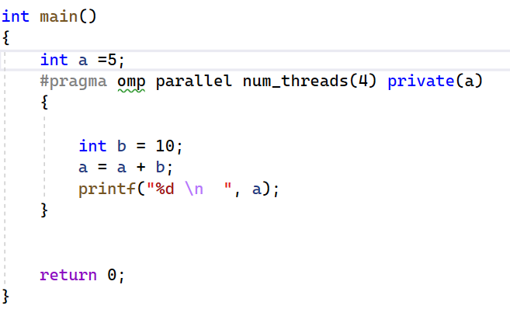
OpenMP: data sharing
Private clause

Slide 45
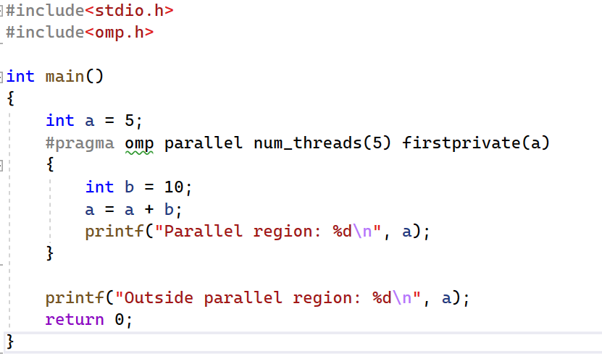
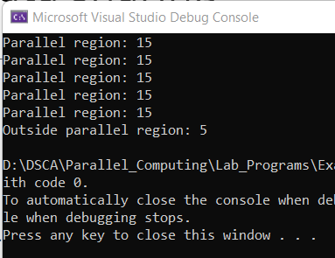
OpenMP: data sharing

Slide 46
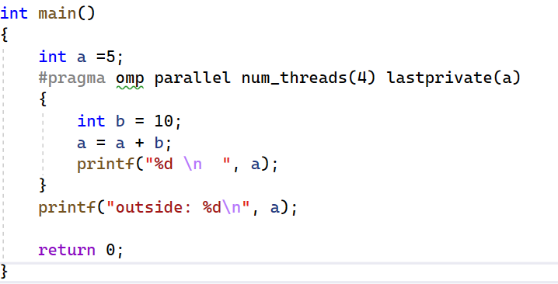
OpenMP: data sharing

Slide 47
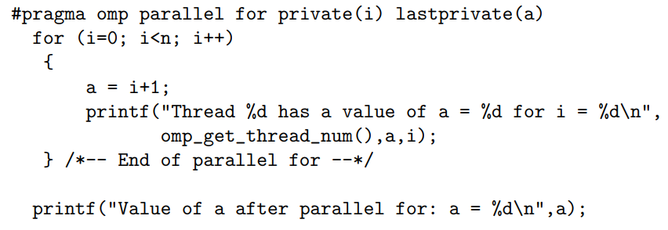
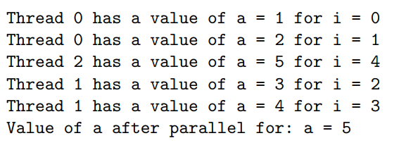
OpenMP: data sharing

Slide 48
OpenMP: data sharing
Default clause:
The default clause is used to give variables a default data-sharing attribute
For example, default(shared) assigns the shared attribute to all variables referenced in the construct.
The default(private) clause makes all variables private by default
Not supported in C/C++ (supported only in Fortran)
This clause is most often used to define the data-sharing attribute of most of the variables in a parallel region
If default(none) is specified instead, the programmer is forced to specify a data-sharing attribute for each variable in the construct

Slide 49
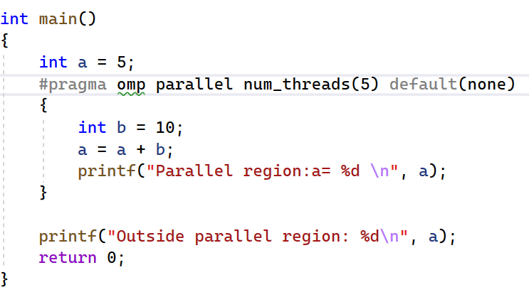
OpenMP: data sharing

Slide 50
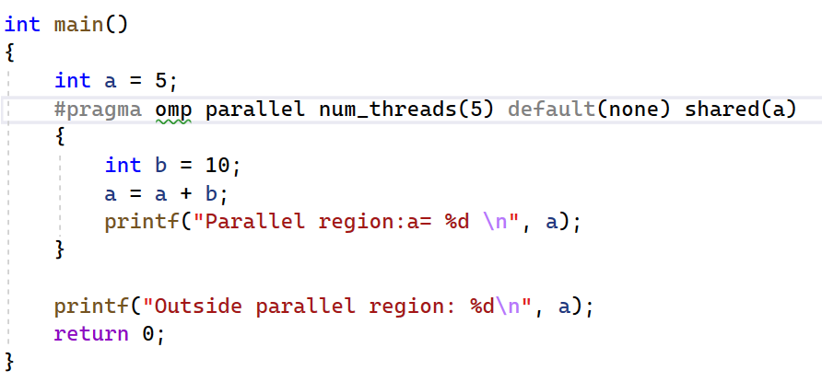
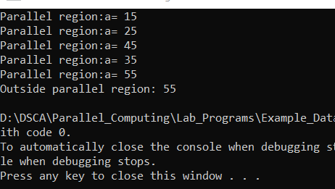
OpenMP: data sharing

Slide 51
OpenMP: Nowait clause
The nowait clause allows the programmer to fine-tune a program’s performance
This clause overrides that feature of OpenMP
If it is added to a construct, the barrier at the end of the associated construct will be suppressed
Note: however, that the barrier at the end of a parallel region cannot be suppressed
One can try to identify places where a barrier is not needed and insert the nowait clause

Slide 52
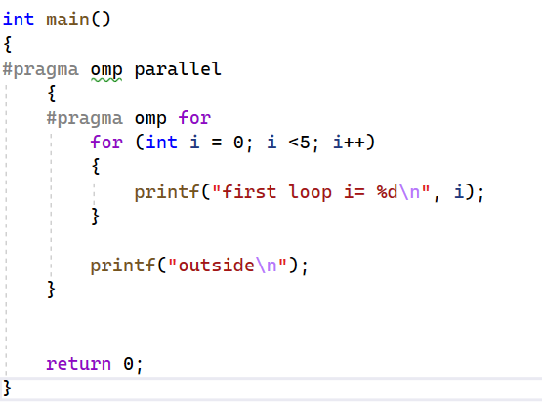
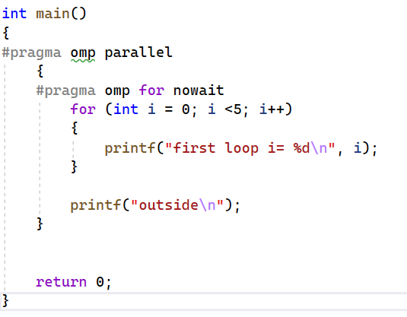
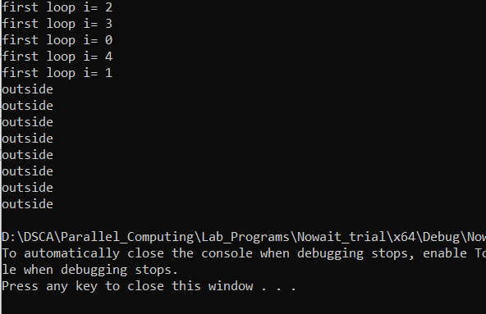
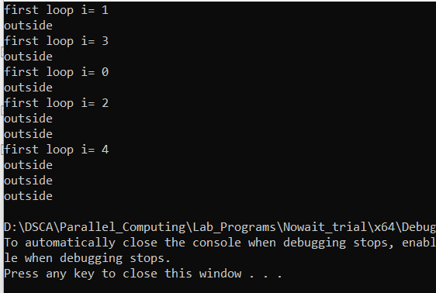
OpenMP: Nowait clause

Slide 53
OpenMP: Schedule Clause
The schedule clause is supported on the loop construct only
It is used to control the manner in which loop iterations are distributed over the threads, which can have a major impact on the performance of a program
The syntax is: schedule(kind [chunk_size] )
The granularity of this workload distribution is a chunk
Note that the chunk_size parameter need not be a constant

Slide 54
OpenMP: Schedule Clause
Static:
Iterations are divided into chunks of size chunk-size
The chunks are assigned to the threads statically in a round-robin manner, in the order of the thread number
The last chunk to be assigned may have a smaller number of iterations
When no chunk size is specified, the iteration space is divided into chunks that are approximately equal in size
Dynamic:
The iterations are assigned to threads as the threads request them
The thread executes the chunk of iterations (controlled through the chunk-size parameter), then requests another chunk until there are no more chunks to work on
The last chunk may have fewer iterations than chunk size. When no chunk size is specified, it defaults to 1

Slide 55
OpenMP: Schedule Clause
Guided
The iterations are assigned to threads as the threads request them
The thread executes the chunk of iterations (controlled through the chunk size parameter), then requests another chunk until there are no more chunks to work on.
For a chunk size of 1, the size of each chunk is proportional to the number of unassigned iterations, divided by the number of threads, decreasing to 1.
For a chunk size of “k” (k > 1), chunks do not contain fewer than k iterations
Runtime
If this schedule is selected, the decision regarding scheduling kind is made at run time

Slide 56
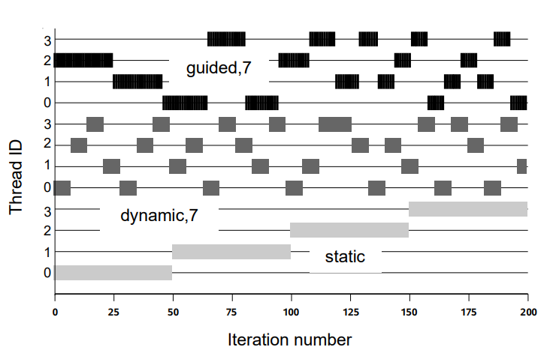
OpenMP: Schedule Clause

Slide 57



OpenMP: Schedule Clause

Slide 58
OpenMP: Synchronization Constructs
An algorithm may require us to manipulate the actions of multiple threads to ensure that updates to a shared variable occur in a certain order
It may simply need to ensure that two threads do not simultaneously attempt to write a shared object
Synchronization Constructs can be used when implicit barrier are not sufficient enough

Slide 59

Synchronization Constructs: Barrier
A barrier is a point in the execution of a program where threads wait for each other
No thread in the team of threads it applies to may proceed beyond a barrier until all threads in the team have reached that point
The compiler automatically inserts a barrier at the end of the construct
Two important restrictions apply to the barrier construct:
Each barrier must be encountered by all threads in a team, or by none at all
The sequence of work-sharing regions and barrier regions encountered must be the same for every thread in the team

Slide 60


Synchronization Constructs: Barrier

Slide 61
Synchronization Constructs: Barrier
The most common use for a barrier is to avoid a data race condition
Inserting a barrier between the writes to and reads from a shared variable guarantees that the accesses are appropriately ordered

Slide 62

Synchronization Constructs: Ordered
Allows one to execute a structured block within a parallel loop in sequential order
This is sometimes used, for instance, to enforce an ordering on the printing of data computed by different threads
Help determine whether there are any data races in the associated code

Slide 63


Synchronization Constructs: Ordered

Slide 64

Synchronization Constructs: Critical
The critical construct provides a means to ensure that multiple threads do not attempt to update the same shared data simultaneously
The associated code is referred to as a critical region, or a critical section
When a thread encounters a critical construct, it waits until no other thread is executing a critical region with the same name

Slide 65


Synchronization Constructs: Critical

Slide 66

Synchronization Constructs: Atomic
The atomic construct, which also enables multiple threads to update shared data without interference, can be an efficient alternative to the critical region
It is applied only to the (single) assignment statement that immediately follows it
The reason it is applied to just one assignment statement is that it protects updates to an individual memory location

Slide 67

Synchronization Constructs: Atomic
If a thread is atomically updating a value, then no other thread may do so simultaneously
This restriction applies to all threads that execute a program, not just the threads in the same team

Slide 68
Synchronization Constructs: Locks
A thread lock is an object that can be held by at most one thread at a time
An OpenMP lock can be in one of the following states:
Uninitialized; Unlocked; or Locked
If a lock is in the unlocked state, a thread can set the lock, which changes its state to locked
The thread that sets the lock is then said to own the lock
A thread that owns a lock can unset that lock, returning it to the unlocked state

Slide 69
Synchronization Constructs: Locks
The general procedure to use locks is as follows:
Define the lock variables using omp_lock_t
Initialize the lock via a call to omp_init_lock()
Set the lock using omp_set_lock() or omp_test_lock(). The latter checks whether the lock is actually available before attempting to set it. It is useful to achieve asynchronous thread execution
Unset a lock after the work is done via a call to omp_unset_lock()
Remove the lock association via a call to omp_destroy_lock()

Slide 70


Synchronization Constructs: Locks

Slide 71
Synchronization Constructs: Master
The master construct defines a block of code that is guaranteed to be executed by the master thread only
It is thus similar to the single construct
The master construct is technically not a work-sharing construct, however, and it does not have an implied barrier on entry or exit
If the master construct is used to initialize data, for example, care needs to be taken that this initialization is completed before the other threads in the team use the data

Slide 72


Synchronization Constructs: Master

Slide 73
OpenMP: The Sections Construct
The sections construct is the easiest way to get different threads to carry out different kinds of work
It permits us to specify several different code regions, each of which will be executed by one of the threads
It consists of two directives:
#pragma omp sections
#pragma omp section
Each section must be a structured block of code that is independent of the other sections

Slide 74

OpenMP: The Sections Construct
At run time, the specified code blocks are executed by the threads in the team
Each thread executes one code block at a time, and each code block will be executed exactly once.

Slide 75



OpenMP: The Sections Construct

Slide 76
OpenMP: Single Construct
The single construct is associated with the structured block of code immediately following it and specifies that this block should be executed by one thread only
It does not state which thread should execute the code block
The other threads wait at a barrier until the thread executing the single code block has completed

Slide 77


OpenMP: Single Construct

Slide 78

OpenMP: Combined Parallel Work-Sharing Constructs
Combined parallel work-sharing constructs are shortcuts that can be used when a parallel region comprises precisely one work-sharing construct

Slide 79
OpenMP: If Clause
The if clause is supported on the parallel construct only, where it is used to specify conditional execution
Since some overheads are inevitably incurred with the creation and termination of a parallel region, it is sometimes necessary to test whether there is enough work in the region to warrant its parallelization
if(scalar-logical-expression )
If the logical expression evaluates to true, which means it is of type integer and has a non-zero value in C/C++, the parallel region will be executed by a team of threads
If it evaluates to false, the region is executed by a single thread only

Slide 80




OpenMP: If Clause

Slide 81
OpenMP: Num_threads Clause
The num threads clause is supported on the parallel construct only
Can be used to specify how many threads should be in the team executing the parallel region
Has higher priority over omp_set_num_threads(4)

Slide 82
OpenMP: Ordered Clause
It does not take any arguments and is supported on the loop construct only
It has to be given if the ordered construct is used in a parallel region, since its purpose is to inform the compiler of the presence of this construct

Slide 83
OpenMP: Reduction Clause
OpenMP provides the reduction clause for specifying some forms of recurrence calculations
They can be performed in parallel without code modification
The programmer must identify the operations and the variables that will hold the result values
reduction(operator :list )
The order in which thread-specific values are combined is unspecified
floating-point data are concerned, there may be numerical differences between the results of a sequential and parallel run

Slide 84




OpenMP: Reduction Clause

Slide 85

OpenMP: Reduction Clause
Aggregate types (including arrays), pointer types, and reference types are not supported.
A reduction variable must not be const-qualified.
The operator specified on the clause can not be overloaded with respect to the variables that appear in the clause

Slide 86
OpenMP: Copyin Clause
Allows us to copy the value of the master thread’s threadprivate variable(s) to the corresponding threadprivate variables of the other threads
Threadprivate:
Static variables are generally shared by default
We can change this by using threadprivate clause (We will discuss this later)
The initial values of private variables are undefined
The copy is carried out after the team of threads is formed and prior to the start of execution of the parallel region, so that it enables a straightforward initialization of this kind of data object.

Slide 87
OpenMP: Copyprivate Clause
The copyprivate clause is supported on the single directive only
It provides a mechanism for broadcasting the value of a private variable from one thread to the other threads in the team
Uses: one thread read or initialize private data that is subsequently used by the other threads as well
After the single construct has ended, but before the threads have left the associated barrier, the values of variables specified in the associated list are copied to the other threads
Since the barrier is essential in this case, the standard prohibits use of this clause in combination with the nowait clause

Slide 88


OpenMP: Copyprivate Clause

Slide 89


OpenMP: Copyprivate Clause

Slide 90
Nested parallelism
If a thread in a team executing a parallel region encounters another parallel construct, it creates a new team and becomes the master of that new team
This is generally referred to in OpenMP as “nested parallelism”
If nested parallelism is not supported
parallel constructs that are nested within other parallel constructs will be ignored
parallel region serialized (executed by a single thread only)
Frequent starting and stopping of parallel regions may introduce a non-trivial performance penalty

Slide 91
Nested parallelism
What will happen if we call omp_get_thread_num() function from the nested region?
It returns the thread id starting from 0 to one less than the number of threads in the current thread team
Thread numbers are no longer unique

Slide 92


Nested parallelism

Slide 93


Nested parallelism

